Slide 1

Firestarter Academy
Transform your life with us

Slide 2
Introduction
Firestarter Academy is a modern digital platform for self-improvement. Our website combines a user-friendly design with state-of-the-art technologies. Six key services include Life and Business Coaching and various personal development workshops.
Unique advantages of our platform include 24/7 online appointment booking system, dark/light theme support and Google login. Secure data management and a responsive interface guarantee a seamless user experience on all devices.

Slide 3
Project Structure
Structure
Objectives
Biztonság
Display: HTML/CSS
Backend: PHP MYSQL
Responsive and Clean code
Jogosultságkezelés, titkosítás

Slide 4
Structure
The architecture of the system follows a three-layer model, where the user interface is based on HTML and CSS, driven by JavaScript. In the middle layer, PHP based server-side logic provides business processes and session management. Data is stored in a MySQL database.
Features
Frontend
50%
Backend
80%

Slide 5



Project development
HTML/CSS/JavaScript → Frontend
PHP → Backend
MySQL → Database

Slide 6
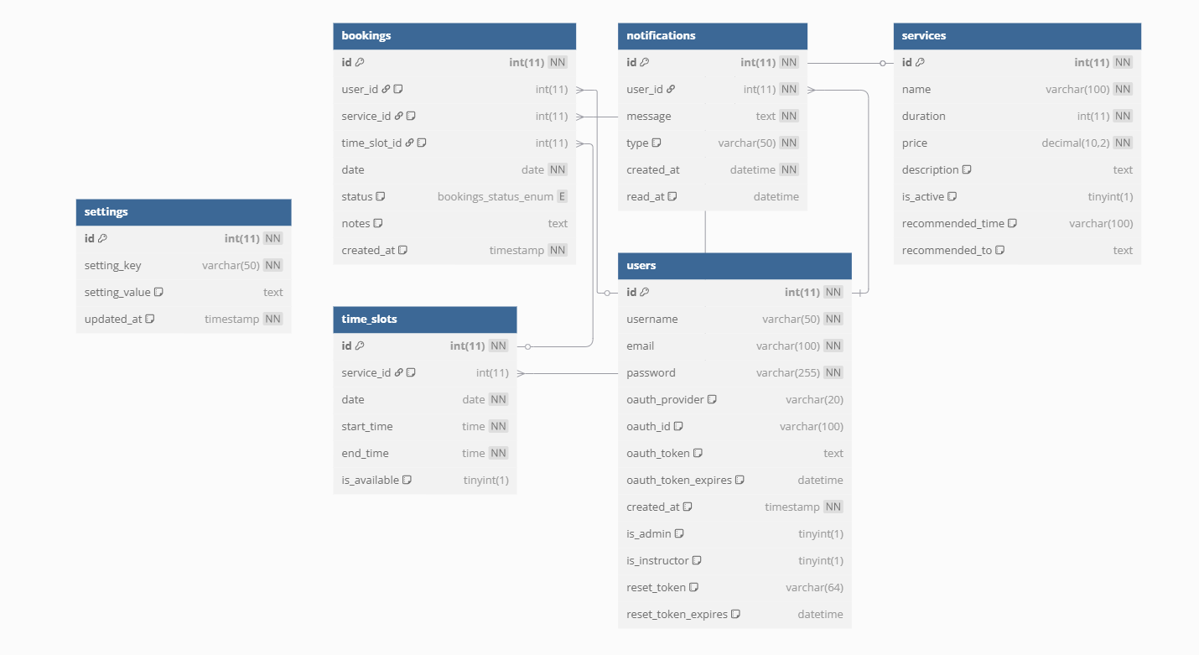
Database
Users table
Stores basic user information such as username, email, hashed password and whether the user is an admin or instructor
Also handles OAuth2 authentication data

Slide 7
Database
Bookings table
Connects users to services
Registers appointments and their status

Slide 8
Database
Handles services table
Stores a service’s name, duration, price and description
Active status management

Slide 9


Contacts and tasks
We divided the tasks according to our strengths.
We used Github to help us coordinate and update the project.
All other details were discussed using Meta’s Messenger.

Slide 10
What are the main parts of the program?
Home page
Registration/login
Training courses
Personal profile
Booking an appointment
Payment page

Slide 11
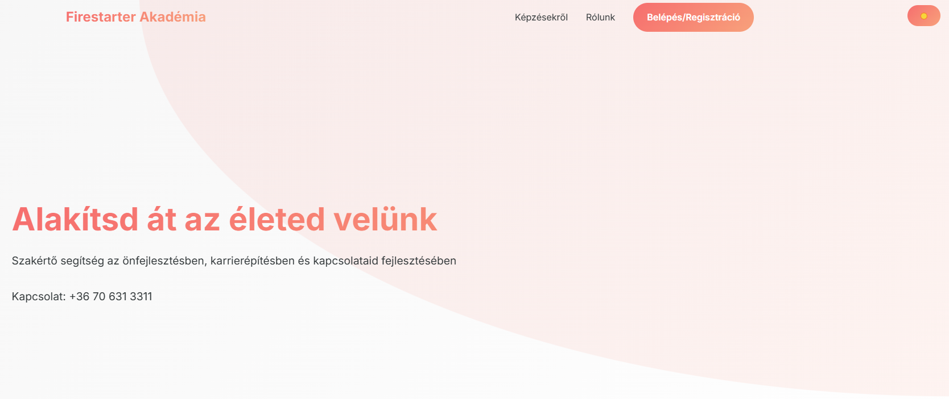
Homepage
A short description can be found here and a navigation bar to get to the other pages

Slide 12
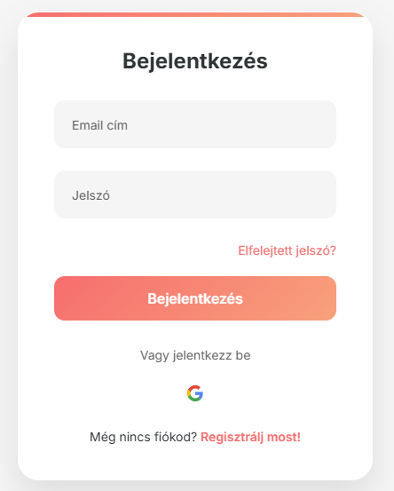
Registration/Login
1. Easy Registration
Enter Email and Password
Choose username
Instant access to the system
2.Oauth2 Login
Login with a Google Account
Secure Authentication
Automatic profile management
3. User permissions
Guest or instructor permissions
Personalised access levels

Slide 13
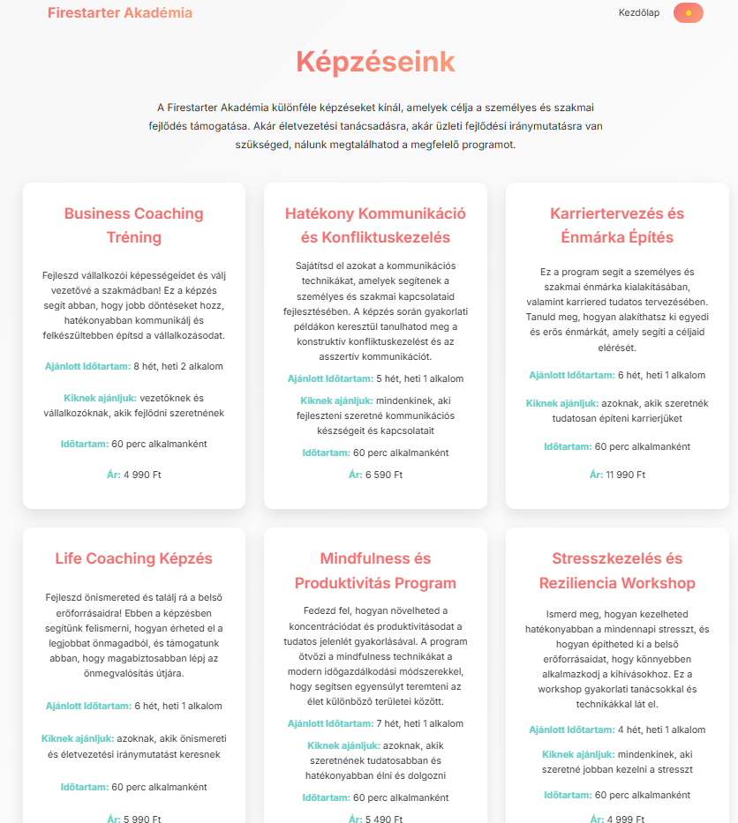
Training Courses
1. Képzések áttekintése
Elérhető kurzusok listája
Részletes képzési leírások
Aktuális árak és időtartamok
2.Jelentkezési folyamat
Online regisztrációs űrlap
Automatikus visszaigazolás
3. Képzési platform funkciók
Személyes profil kezelése
Konzultációk ütemezése

Slide 14
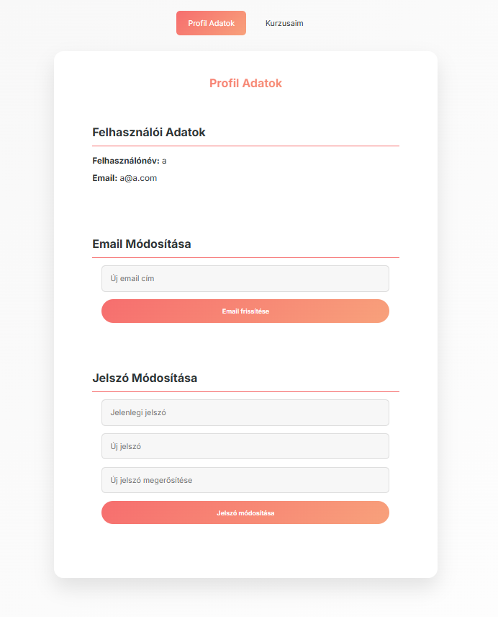
Personal Profile
View/modify booked courses
Personal details
Email address/password change

Slide 15
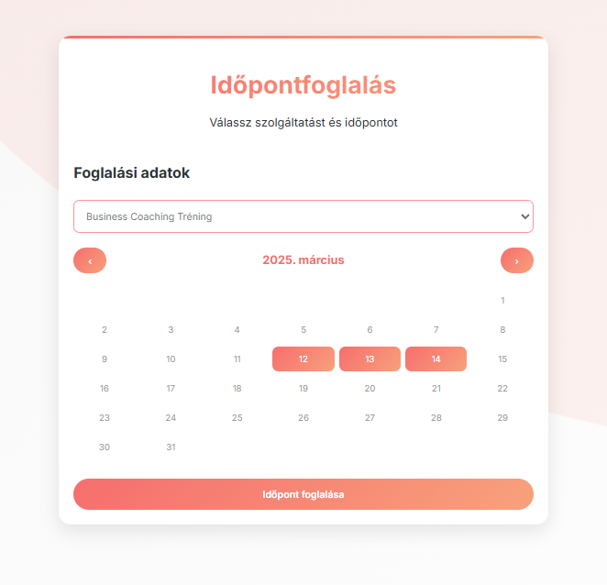
Booking an appointment
Available dates can be selected in calendar format
Book 5 months in advance
After acceptance by the instructor, it will also appear on the user's page, and will be notified by email

Slide 16
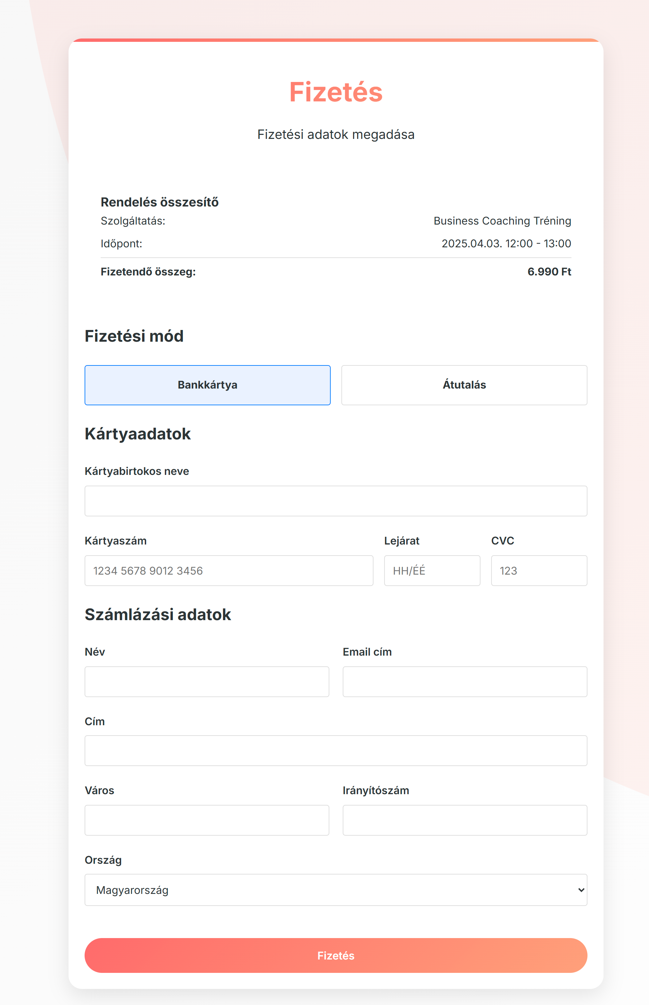
Payment Page
This is used to finalize bookings
Honly after it’s filled with correct details will it let the user proceed
After successful “Payment” the system will finalise the booking

